Slide 1


Hotel Reservation Analysis with SQL
A Data-Driven Approach to Understanding Guest Preferences and Booking Trends
HARISH S K

Slide 2

Purpose of the Analysis
The purpose of this analysis is to leverage SQL for extracting meaningful insights from a hotel reservation dataset. This will help in understanding guest preferences, booking trends, and other key factors that impact the hotel's operations.

Slide 3

Overview of the Dataset
The dataset includes various attributes such as Booking ID, number of adults and children, number of weekend and weeknights, meal plan chosen, room type reserved, lead time, arrival date, market segment type, average price per room, and booking status.

Slide 4

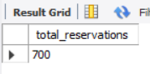
Question 1: What is the total number of reservations in the dataset?
SQL Query
SELECT COUNT(Booking_ID) AS total_reservations
FROM `hotel reservation dataset’;

Slide 5

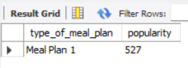
Question 2: Which meal plan is the most popular among guests?
SQL Query
SELECT type_of_meal_plan, COUNT(type_of_meal_plan) AS popularity
FROM `hotel reservation dataset’
GROUP BY type_of_meal_plan
ORDER BY popularity DESC
LIMIT 1;

Slide 6

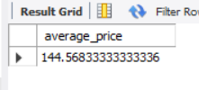
Question 3: What is the average price per room for reservations involving children?
SQL Query
SELECT AVG(avg_price_per_room) AS average_price
FROM `hotel reservation dataset’
WHERE no_of_children > 0;

Slide 7

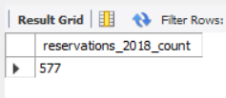
Question 4: How many reservations were made for the year 2018?
SQL Query
SELECT COUNT(*) AS reservations_2018_count
FROM `hotel reservation dataset’
WHERE YEAR(STR_TO_DATE(arrival_date, '%d/%m/%Y')) = 2018;

Slide 8
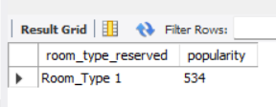
Question 5: What is the most commonly booked room type?
SQL Query
SELECT room_type_reserved, COUNT(room_type_reserved) AS popularity
FROM `hotel reservation dataset’ GROUP BY room_type_reserved
ORDER BY popularity DESC
LIMIT 1;
Notes:
.

Slide 9
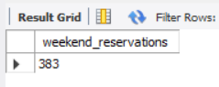
Question 6: How many reservations fall on a weekend?
SQL Query
SELECT COUNT(Booking_ID) AS weekend_reservations
FROM `hotel reservation dataset’
WHERE no_of_weekend_nights > 0;

Slide 10

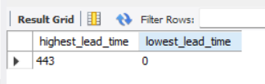
Question 7: What is the highest and lowest lead time for reservations?
SQL Query
SELECT MAX(lead_time) AS highest_lead_time, MIN(lead_time) AS lowest_lead_time FROM `hotel reservation dataset`;

Slide 11
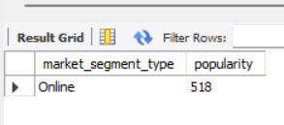
Question 8: What is the most common market segment type for reservations?
SQL Query
SELECT market_segment_type, COUNT(market_segment_type) AS popularity
FROM `hotel reservation dataset’ GROUP BY market_segment_type
ORDER BY popularity DESC
LIMIT 1;

Slide 12
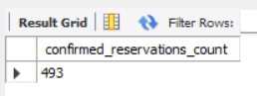
Question 9: How many reservations have a booking status of 'Confirmed'?
SQL Query
SELECT COUNT(Booking_ID) AS confirmed_reservations_count FROM `hotel reservation dataset`
WHERE booking_status = 'Not_canceled';

Slide 13
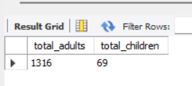
Question 10: What is the total number of adults and children across all reservations?
SQL Query
SELECT SUM(no_of_adults) AS total_adults, SUM(no_of_children) AS total_children
FROM `hotel reservation dataset`;

Slide 14
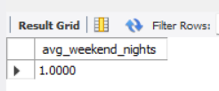
Question 11: What is the average number of weekend nights for reservations involving children?
SQL Query
SELECT AVG(no_of_weekend_nights) AS avg_weekend_nights
FROM `hotel reservation dataset’
WHERE no_of_children > 0;

Slide 15
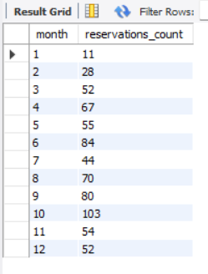
Question 12: How many reservations were made in each month of the year?
SQL Query
SELECT MONTH(STR_TO_DATE(arrival_date, '%d/%m/%Y')) AS month, COUNT(*) AS reservations_count
FROM `hotel reservation dataset’
GROUP BY MONTH(STR_TO_DATE(arrival_date, '%d/%m/%Y'))ORDER BY month;
Notes:
.

Slide 16
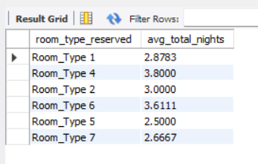
Question 13: What is the average number of nights (both weekend and weekday) spent by guests for each room type?
SQL Query
SELECT room_type_reserved, AVG(no_of_weekend_nights + no_of_week_nights) AS avg_total_nights
FROM `hotel reservation dataset`
GROUP BY room_type_reserved;

Slide 17
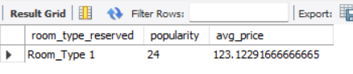
Question 14: For reservations involving children, what is the most common room type, and what is the average price for that room type?
SQL Query
SELECT room_type_reserved, COUNT(room_type_reserved) AS popularity, AVG(avg_price_per_room) AS avg_price
FROM `hotel reservation dataset’
WHERE no_of_children > 0 GROUP BY room_type_reserved ORDER BY popularity DESC
LIMIT 1;

Slide 18
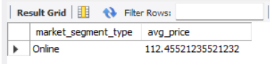
Question 15: Find the market segment type that generates the highest average price per room
SQL Query
SELECT market_segment_type, AVG(avg_price_per_room) AS avg_price
FROM `hotel reservation dataset’
GROUP BY market_segment_type ORDER BY avg_price DESC LIMIT 1;

Slide 19

CONCLUSION
This analysis provides valuable insights into the booking patterns and preferences of hotel guests. By leveraging SQL queries to interrogate the dataset, the presentation uncovered the following key findings:
Reservation Volume: The hotel managed 700 reservations, with notable peaks and troughs across different months of the year.
Guest Preferences: Meal Plan 1 emerged as the most popular choice among guests, while Room_Type 1 was the most booked room type.
Pricing Insights: The average price per room for reservations involving children was higher than the general average, highlighting the potential for targeted family-oriented pricing strategies.
Booking Behaviour: The lead time for reservations varied significantly, with the longest lead time being 443 days, indicating that some guests plan their stays well in advance.
Market Segments: The online market segment not only accounted for most bookings but also generated the highest average price per room, underscoring the importance of a strong online presence and effective digital marketing.

Slide 20

CONCLUSION
These insights can help the hotel management in optimizing their operations, enhancing guest satisfaction, and implementing targeted marketing strategies to drive revenue growth. By understanding guest behaviours and preferences, the hotel can tailor its services to meet the evolving needs of its clientele, ultimately ensuring a superior guest experience and sustained business success.

